Slide 1
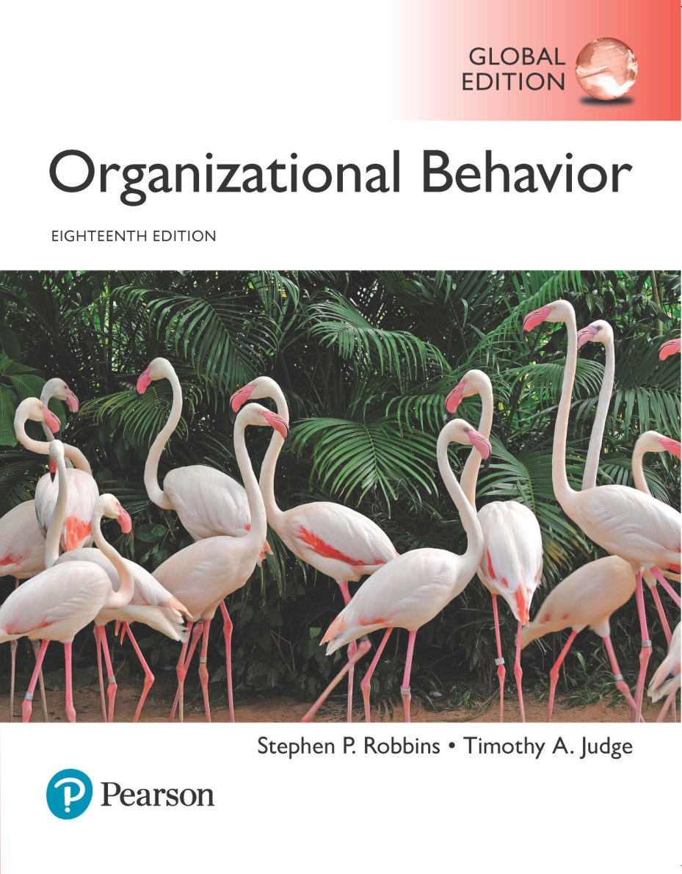
Organizational Behavior
Eighteenth Edition, Global Edition
Chapter 11
Power and Politics
Copyright © 2019 Pearson Education, Ltd. All Rights Reserved.
Notes:
If this PowerPoint presentation contains mathematical equations, you may need to check that your computer has the following installed:
1) MathType Plugin
2) Math Player (free versions available)
3) NVDA Reader (free versions available)
Welcome to this Organizational Behavior course that uses the 18th edition of the textbook, Organizational Behavior by Robbins and Judge. This is considered among the most widely used OB textbooks in the world. Robbins and Judge are recognized as definitive aggregators of OB concepts, applications, and practices. The course and this book will provide you with a resource that will benefit you throughout your degree program and your professional life.
Chapter 13: Power and Politics

Slide 2
Learning Objectives (1 of 2)
11.1 Contrast leadership and power.
11.2 Explain the three bases of formal power and the two bases of personal power.
11.3 Explain the role of dependence in power relationships.
11.4 Identify power or influence tactics and their contingencies.
Notes:
After studying this chapter, you should be able to:
Contrast leadership and power.
Explain the three bases of formal power and the two bases of personal power.
Explain the role of dependence in power relationships.
Identify power or influence tactics and their contingencies.

Slide 3
Learning Objectives (2 of 2)
11.5 Identify the causes and consequences of abuse of power.
11.6 Describe how politics work in organizations.
11.7 Identify the causes, consequences, and ethics of political behavior.
Notes:
Additional objectives for this chapter.
Identify the causes and consequences of abuse of power.
Describe how politics work in organizations.
Identify the causes, consequences, and ethics of political behavior.

Slide 4
Define Power and Contrast Leadership and Power (1 of 2)
Power refers to a capacity that A has to influence the behavior of B, so that B acts in accordance with A’s wishes.
  Power may exist but not be used.
Probably the most important aspect of power is that it is a function of dependence.
  A person can have power over you only if he or she controls something you desire.
Notes:
Power refers to a capacity that A has to influence the behavior of B, so that B acts in accordance with A’s wishes. Power may exist but not be used. It is, therefore, a capacity or potential. Probably the most important aspect of power is that it is a function of dependence. The greater B’s dependence on A, the greater is A’s power in the relationship. Dependence, in turn, is based on alternatives that B perceives and the importance that B places on the alternative(s) that A controls. A person can have power over you only if he or she controls something you desire.

Slide 5
Define Power and Contrast Leadership and Power (2 of 2)
Leaders use power as a means of attaining group goals.
  Goal compatibility
    Power does not require goal compatibility, merely dependence.
  The direction of influence.
    Leadership focuses on the downward influence on one’s followers.
  Leadership research emphasizes style.
Notes:
What is the difference between leadership and power? Leaders use power as a means of attaining group goals. Power doesn’t require goal compatibility, just dependence. In contrast, leadership requires some congruence between the goals of the leader and those being led. The direction of influence for leaders is downward.
Leadership research, for the most part, emphasizes style. The research on power focuses on tactics for gaining compliance. It goes beyond the individual as the exercise of power, because groups as well as individuals can use power to control other individuals or groups.

Slide 6
Explain Formal Power and Personal Power (1 of 2)
Formal Power
  Coercive Power
  Reward Power
  Legitimate Power
Personal Power
  Expert Power
  Referent Power
Notes:
We can divide power into two general groupings: formal and personal.
Formal power is based on an individual’s position in an organization. There are three types of formal power: coercive, reward, and legitimate. Coercive power depends on fear of negative results. It rests on the application, or the threat of application, of physical sanctions such as the infliction of pain, the generation of frustration through restriction of movement, or the controlling by force of basic physiological or safety needs. At the organizational level, A has coercive power over B if A can dismiss, suspend, or demote B, assuming that B values his or her job. Similarly, if A can assign B work activities that B finds unpleasant or treat B in a manner that B finds embarrassing, A possesses coercive power over B.
Reward power is the opposite of coercive power. People comply because doing so produces positive benefits; therefore, one who can distribute rewards that others view as valuable will have power over those others. These rewards can be either financial—such as controlling pay rates, raises, and bonuses—or nonfinancial, including recognition, promotions, interesting work assignments, friendly colleagues, and preferred work shifts or sales territories.
Legitimate power is shown in formal groups and organizations through one’s structural position. It represents the power a person receives as a result of his or her position in the formal hierarchy. Legitimate power is broader than the power to coerce and reward. It includes acceptance of the authority of a position by members of an organization.
The second group of power—personal power—comes from an individual’s unique characteristics, and includes expert power and referent power. Expert power is influence wielded as a result of expertise, special skill, or knowledge. As jobs become more specialized, we become increasingly dependent on experts to achieve goals. Referent power’s source is identification with a person who has desirable resources or personal traits. If I admire and identify with you, you can exercise power over me because I want to please you. Referent power develops out of admiration of another and a desire to be like that person; it is a lot like charisma. It also explains why celebrities are paid millions of dollars to endorse products in commercials. Some people who are not in formal leadership positions nonetheless have referent power and exert influence over others because of their charismatic dynamism, likability, and emotional effects on us.

Slide 7
Explain Formal Power and Personal Power (2 of 2)
Which Bases of Power Are Most Effective?
  Personal sources are most effective.
  Both expert and referent power are positively related to employees’ satisfaction with supervision, their organizational commitment, and their performance, whereas reward and legitimate power seem to be unrelated to these outcomes.
  Coercive power can be damaging.
Notes:
Which bases of power are most effective? Personal sources are most effective. Both expert and referent power are positively related to employees’ satisfaction with supervision, their organizational commitment, and their performance, whereas reward and legitimate power seem to be unrelated to these outcomes. Coercive power can be damaging.

Slide 8
Explain the Role of Dependence in Power Relationships (1 of 3)
The General Dependency Postulate
  When you possess anything others require but that you alone control, you make them dependent upon you and, therefore, you gain power over them.
  Dependence, then, is inversely proportional to the alternative sources of supply.
Notes:
The general dependency postulate says the greater B’s dependency on A, the greater the power A has over B. When you possess anything that others require but that you alone control, you make them dependent upon you and, therefore, you gain power over them. Dependency, then, is inversely proportional to the alternative sources of supply. This is why most organizations develop multiple suppliers rather than using just one. It also explains why so many of us aspire to financial independence.

Slide 9
Explain the Role of Dependence in Power Relationships (2 of 3)
What Creates Dependence?
  Importance
  Scarcity
  Nonsubstitutability
Notes:
What creates dependence? To create dependence, the thing(s) you control must be perceived as being important. However, note that there are many degrees of importance, from needing the resource for survival to wanting a resource that is in fashion or adds to convenience.
A resource also needs to be perceived as scarce to create dependence. The scarcity–dependency relationship can further be seen in the power of occupational categories. Individuals in occupations in which the supply of personnel is low relative to demand can negotiate compensation and benefit packages far more attractive than can those in occupations where there is an abundance of candidates.
Nonsubstitutability means the fewer viable substitutes for a resource, the more power control that resource provides.

Slide 10
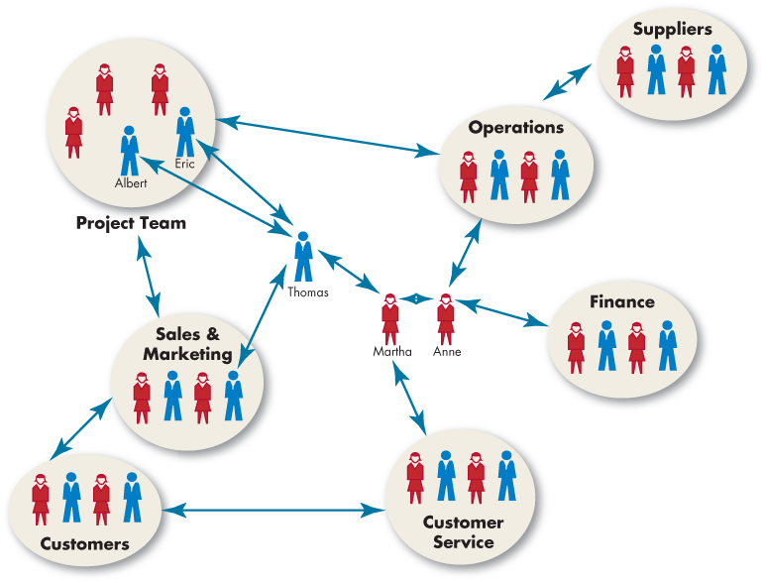
Explain the Role of Dependence in Power Relationships (3 of 3)
Exhibit 11-1 An Organizational Sociogram
Notes:
One tool to assess the exchange of resources and dependencies within an organization is social network analysis. This method examines patterns of communication among organizational members to identify how information flows between them.
Within a social network, or connections between people who share professional interests, each individual or group is called a node, and the links between nodes are called ties. When nodes communicate or exchange resources frequently, they are said to have very strong ties.
Exhibit 13-1 shows a graphical illustration of the associations among individuals in a social network, called a sociogram. It functions like an informal version of an organization chart. The difference is that a formal organization chart shows how authority is supposed to flow, whereas a sociogram shows how resources really flow in an organization.
Networks can create substantial power dynamics such as enforcing norms or creating change within an organization. So, employees who have many connections to an organizational social network are less likely to engage in corruption. Those in the position of brokers tend to have more power because they can leverage the unique resources they can acquire from different groups. In other words, many people are dependent upon brokers, which gives the brokers more power.
There are many ways to implement a social network analysis in an organization. Some organizations keep track of the flow of e-mail communications or document sharing across departments. Other organizations look at data from human resources information systems, analyzing how supervisors and subordinates interact with one another.

Slide 11
Identify Power or Influence Tactics and their Contingencies
Influence tactics:
  Legitimacy
  Rational persuasion
  Inspirational appeals
  Consultation
  Exchange
  Personal appeals
  Ingratiating
  Pressure
  Coalitions
Notes:
Research has identified nine distinct influence or power tactics.
First is legitimacy: relying on your authority position or saying a request accords with organizational policies or rules.
Second is rational persuasion: presenting logical arguments and factual evidence to demonstrate a request is reasonable.
Third is inspirational appeals: developing emotional commitment by appealing to a target’s values, needs, hopes, and aspirations.
Fourth is consultation: increasing the target’s support by involving him or her in deciding how you will accomplish your plan.
Fifth is exchange: rewarding the target with benefits or favors in exchange for following a request.
Sixth is personal appeals: asking for compliance based on friendship or loyalty.
Seventh is ingratiation: using flattery, praise, or friendly behavior prior to making a request.
Eighth is pressure: using warnings, repeated demands, and threats.
Nine is coalitions: enlisting the aid or support of others to persuade the target to agree.

Slide 12
Identify Nine Power or Influence Tactics and their Contingencies (1 of 4)
Some tactics are more effective than others.
  Rational persuasion, inspirational appeals, and consultation are most effective when the audience is highly interested in the outcomes.
  Pressure tends to backfire.
  Both ingratiation and legitimacy can lessen the negative reactions from appearing to “dictate” outcomes.
Notes:
Some tactics are more effective than others. Rational persuasion, inspirational appeals, and consultation tend to be the most effective, especially when the audience is highly interested in the outcomes of a decision process. Pressure tends to backfire and is typically the least effective of the nine tactics.
You can also increase your chance of success by using more than one type of tactic at the same time or sequentially, as long as your choices are compatible. Using both ingratiation and legitimacy can lessen the negative reactions from appearing to “dictate” outcomes, but only when the audience does not really care about the outcomes of a decision process or the policy is routine.

Slide 13
Identify Nine Power or Influence Tactics and their Contingencies (2 of 4)
Exhibit 11-2 Preferred Power Tactics by Influence Direction
Upward Influence | Downward Influence | Lateral Influence
Rational persuasion | Rational persuasion | Rational persuasion
Blank | Inspirational appeals | Consultation
Blank | Pressure | Ingratiation
Blank | Consultation | Exchange
Blank | Ingratiation | Legitimacy
Blank | Exchange | Personal appeals
Blank | Legitimacy | Coalitions
Notes:
As Exhibit 13-2 shows, rational persuasion is the only tactic effective across organizational levels. Inspirational appeals work best as a downward influencing tactic with subordinates. When pressure works, it’s generally downward only. Personal appeals and coalitions are most effective as lateral influence. Other factors that affect the effectiveness of influence include the sequencing of tactics, a person’s skill in using the tactic, and the organizational culture.
You’re more likely to be effective if you begin with “softer” tactics that rely on personal power, such as personal and inspirational appeals, rational persuasion, and consultation. If these fail, you can move to “harder” tactics, such as exchange, coalitions, and pressure, which emphasize formal power and incur greater costs and risks. Interestingly, a single soft tactic is more effective than a single hard tactic, and combining two soft tactics or a soft tactic and rational persuasion is more effective than any single tactic or combination of hard tactics.
The effectiveness of tactics depends on the audience. People especially likely to comply with soft power tactics tend to be more reflective, are intrinsically motivated, have high self-esteem, and have greater desire for control. In contrast, people especially likely to comply with hard power tactics are more action-oriented and extrinsically motivated, and are more focused on getting along with others than with getting their own way.

Slide 14
Identify Nine Power or Influence Tactics and their Contingencies (3 of 4)
People in different countries prefer different power tactics.
  Individualistic countries see power in personalized terms and as a legitimate means of advancing their personal ends.
  Collectivistic countries see power in social terms and as a legitimate means of helping others.
Notes:
People in different countries prefer different power tactics. Those from individualistic countries tend to see power in personalized terms and as a legitimate means of advancing their personal ends, whereas those in collectivistic countries see power in social terms and as a legitimate means of helping others.
A study comparing managers in the United States and China found that U.S. managers prefer rational appeal, whereas Chinese managers prefer coalition tactics. These differences tend to be consistent with the values in these two countries. The reason is consistent with the U.S. preference for direct confrontation and rational persuasion to influence others and resolve differences, while coalition tactics align with the Chinese preference for meeting difficult or controversial requests with indirect approaches.

Slide 15
Identify Nine Power or Influence Tactics and their Contingencies (4 of 4)
Applying Power Tactics
  People differ in terms of their political skill: their ability to influence others to enhance their own objectives.
    The politically skilled are more effective users of all the influence tactics.
  Cultures within organizations differ markedly: some are warm, relaxed, and supportive; others are formal and conservative.
    People who fit the culture of the organization tend to obtain more influence.
Notes:
People differ in terms of their political skill – their ability to influence others to enhance their own objectives. The politically skilled are more effective users of all influence tactics, leading to many positive outcomes in the workplace. People who are politically skilled have higher self-efficacy, job satisfaction, work productivity, and career success. They are less likely to be victims of workplace aggression. Political skill also appears more effective when the stakes are high.
Finally, the politically skilled are able to exert their influence without others detecting it, a key element in effectiveness.
Also, we know that cultures within organizations differ markedly: some are warm, relaxed, and supportive; others are formal and conservative. Some cultures encourage participation and consultation, some encourage reason, and still others rely on pressure. People who fit the culture of the organization tend to obtain more influence. Specifically, extraverts tend to be more influential in team-oriented organizations, and highly conscientious people are more influential in organizations that value working alone on technical tasks. Part of the reason people who fit the culture are influential is that they are able to perform especially well in the domains deemed most important for success. In other words, they are influential because they are competent. So the organization itself will influence which subset of power tactics is viewed as acceptable for use.

Slide 16
Causes and Consequences of Abuse of Power (1 of 4)
Does power corrupt?
    Power leads people to place their own interests ahead of others.
    Powerful people react, especially negatively, to any threats to their competence.
    Power leads to overconfident decision making.
    Power doesn’t affect everyone in the same way, and there are even positive effects of power.
Notes:
Does power corrupt? Evidence suggests that power leads people to place their own interests ahead of others. Powerful people react—especially negatively—to any threats to their competence. Power also leads to overconfident decision making. Power doesn’t affect everyone in the same way, and there are even positive effects of power. Let’s consider each of these in turn.
First, the toxic effects of power depend on one’s personality. Research suggests that if we have an anxious personality, power does not corrupt us because we are less likely to think that using power benefits us. Second, the corrosive effect of power can be contained by organizational systems. One study found, for example, that while power made people behave in a self-serving manner, when accountability of this behavior was initiated, the self-serving behavior stopped. Third, we have the means to blunt the negative effects of power. One study showed that simply expressing gratitude toward powerful others makes them less likely to act aggressively against us.
Finally, remember the aphorism that those with little power grab and abuse what little they have? There appears to be some truth to this in that the people most likely to abuse power are those who are low in status and gain power. Why is this the case? It appears that having low status is threatening, and this fear is used in negative ways if power is given.
As you can see, there are factors that can ameliorate the negative effects of power. But there also appear to be generally positive effects. Power can energize people and motivate them to achieve goals (i.e., approach motivation). It also can enhance people’s motivation to help others, at least for certain people. It is not so much that power corrupts as it reveals. For those with strong moral identities, power actually enhanced their moral awareness. And willingness to act.

Slide 17
Causes and Consequences of Abuse of Power (2 of 4)
Sexual harassment: any unwanted activity of a sexual nature that affects an individual’s employment and creates a hostile work environment.
  Organizations have generally made progress in the past decade toward limiting overt forms of sexual harassment.
Managers have a responsibility to protect their employees from a hostile work environment, but they also need to protect themselves.
Notes:
Sexual harassment is defined as any unwanted activity of a sexual nature that affects an individual’s employment and creates a hostile work environment.
Organizations have generally made progress in the past decade toward limiting overt forms of sexual harassment. Generally, sexual harassment is more prevalent in male-dominated societies. Most studies confirm that the concept of power is central to understanding sexual harassment.
The bottom line is that managers have a responsibility to protect their employees from a hostile work environment, but they also need to protect themselves.

Slide 18
Causes and Consequences of Abuse of Power (3 of 4)
Mangers should:
  Make sure an active policy defines what constitutes sexual harassment, informs employees they can be fired for sexually harassing another employee, and establishes procedures for how complaints can be made.
  Reassure employees that they will not encounter retaliation if they issue a complaint.
Notes:
The following are some ways managers can protect themselves and their employees from sexual harassment:
Make sure an active policy defines what constitutes sexual harassment, informs employees they can be fired for sexually harassing another employee, and establishes procedures for how complaints can be made.
Reassure employees that they will not encounter retaliation if they issue a complaint.

Slide 19
Causes and Consequences of Abuse of Power (4 of 4)
In addition, managers should:
  Investigate every complaint and include the legal and human resource departments.
  Make sure offenders are disciplined or terminated.
  Set up in-house seminars to raise employee awareness of the issues surrounding sexual harassment.
Notes:
Managers also need to:
Investigate every complaint and include the legal and human resource departments.
Make sure offenders are disciplined or terminated.
Set up in-house seminars to raise employee awareness of the issues surrounding sexual harassment.

Slide 20
Describe How Politics Work in Organizations (1 of 2)
Political behavior: activities that are not required as part of one’s formal role in the organization, but that influence the distribution of advantages within the organization.
  Outside of one’s specified job requirements.
  Encompasses efforts to influence decision- making goals, criteria, or processes.
  Includes such behaviors as withholding information, whistle-blowing, spreading rumors, and leaking confidential information.
Notes:
Political behavior is defined as those activities that are not required as part of one’s formal role in the organization, but that influence, or attempt to influence, the distribution of advantages and disadvantages within the organization. This definition encompasses key elements. Political behavior is outside one’s specified job requirements. It encompasses efforts to influence the goals, criteria, or processes used for decision making. It includes such varied political behaviors as withholding key information from decision makers, whistle-blowing, spreading rumors, and leaking confidential information.

Slide 21
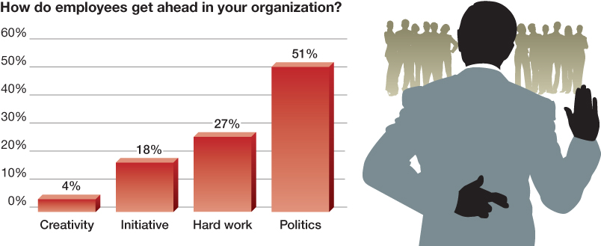
Describe How Politics Work in Organizations (2 of 2)
OB POLL Importance of Organizatoinal Politics from
Source: Based on D. Crampton, “Is How Americans Feel about Their Jobs Changing?” (September 28, 2012), http://corevalues.com/employee-motivation/is-how-americans-feel-about-their-jobs-changing.
Notes:
As the OB Poll shows, politics are not only inevitable, they might be essential too. People want to carve out a niche to exert influence, earn rewards, and advance their careers.

Slide 22
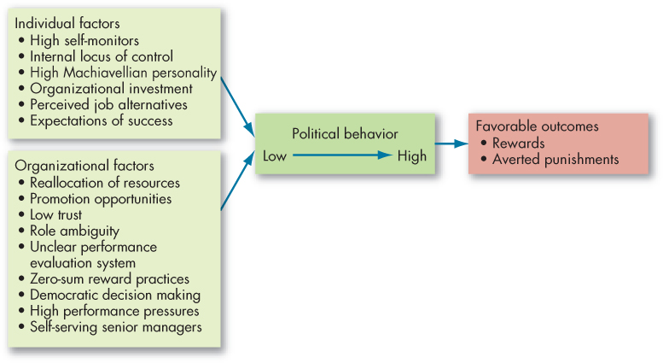
Causes and Consequences of Political Behavior (1 of 7)
Exhibit 11-3 Factors That Influence Political Behavior
Notes:
Factors contributing to political behavior, as shown here in Exhibit 13-3, include individual factors. Researchers have identified certain personality traits, needs, and other factors that are likely to be related to political behavior. Employees who are high self-monitors, possess an internal locus of control, and have a high need for power are more likely to engage in political behavior. The high self-monitor is more sensitive to social cues and is more likely to be skilled in political behavior than the low self-monitor. Individuals with an internal locus of control are more prone to take a proactive stance and attempt to manipulate situations in their favor. The Machiavellian personality is comfortable using politics as a means to further his/her self-interest. An individual’s investment in the organization, perceived alternatives, and expectations of success will also influence the tendency to pursue illegitimate means of political action.
The organizational factors that influence politics are many. Political activity is probably more a function of the organization’s characteristics than of individual difference variables. When an organization’s resources are declining, when the existing pattern of resources is changing, and when there is opportunity for promotions, politics is more likely to surface. Cultures characterized by low trust, role ambiguity, unclear performance evaluation systems, zero-sum reward allocation practices, democratic decision making, high pressures for performance, and self-serving senior managers will create breeding grounds for politicking. When organizations downsize to improve efficiency, people may engage in political actions to safeguard what they have. Promotion decisions have consistently been found to be one of the most political in organizations.

Slide 23
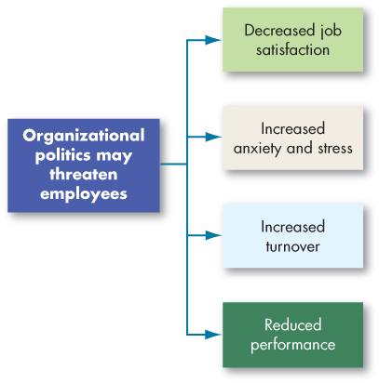
Causes and Consequences of Political Behavior (2 of 7)
Exhibit 11-4 Employee Responses to Organizational Politics from
Notes:
For most people, those who have modest political skills or are unwilling to play the politics game, outcomes tend to be predominantly negative. Exhibit 13-4 summarizes the extensive research on the relationship between organizational politics and individual outcomes. There is very strong evidence indicating that perceptions of organizational politics are negatively related to job satisfaction. The perception of politics leads to anxiety or stress. When it gets to be too much to handle, employees quit.
When employees of two agencies in a recent study in Nigeria viewed their work environments as political, they reported higher levels of job distress and were less likely to help their coworkers. Thus, although developing countries such as Nigeria are perhaps more ambiguous and more political environments in which to work, the negative consequences of politics appear to be the same as in the United States.

Slide 24
Causes and Consequences of Political Behavior (3 of 7)
Exhibit 11-5 Defensive Behaviors
Avoiding Action
Overconforming. Strictly interpreting your responsibility by saying things like “The rules clearly state...”or “This is the way we’ve always done it.” Buck passing. Transferring responsibility for the execution of a task or decision to someone else. Playing dumb. Avoiding an unwanted task by falsely pleading ignorance or inability. Stretching. Prolonging a task so that one person appears to be occupied—for example, turning a two-week task into a 4-month job. Stalling. Appearing to be more or less supportive publicly while doing little or nothing privately.
Avoiding Blame
Bluffing. Rigorously documenting activity to project an image of competence and thoroughness, known as “covering your rear.” Playing safe. Evading situations that may reflect unfavorably. It includes taking on only projects with a high probability of success, having risky decisions approved by superiors, qualifying expressions of judgment, and taking neutral positions in conflicts. Justifying. Developing explanations that lessen one’s responsibility for a negative outcome and/or apologizing to demonstrate remorse, or both.
Notes:
The politics–performance relationship appears to be moderated by an individual’s understanding of the “hows” and “whys” of organizational politics. Political behavior and work moderates the effects of ethical leadership.
When employees see politics as a threat, they often respond with defensive behaviors—reactive and protective behaviors to avoid action, blame, or change. Exhibit 13-5 provides some examples of these behaviors. Defensive behaviors are often associated with negative feelings toward the job and work environment. In the short run, employees may find that defensiveness protects their self-interest, but in the long run it wears them down. People who consistently rely on defensiveness find that, eventually, it is the only way they know how to behave. At that point, they lose the trust and support of their peers, bosses, employees, and clients.

Slide 25
Causes and Consequences of Political Behavior (4 of 7)
[Exhibit 11-5 Continued]
Scapegoating. Placing the blame for a negative outcome on external factors that are not entirely blameworthy. Misrepresenting. Manipulation of information by distortion, embellishment, deception, selective presentation, or obfuscation.
Avoiding Change
Prevention. Trying to prevent a threatening change from occurring. Self-protection. Acting in ways to protect one’s self-interest during change by guarding information or other resources.
Notes:
The politics-performance relationship appears to be moderated by an individual’s understanding of the “hows” and “whys” of organizational politics. Political behavior and work moderates the effects of ethical leadership.
When employees see politics as a threat, they often respond with defensive behaviors — reactive and protective behaviors to avoid action, blame, or change. Exhibit 13-5 provides some examples of these behaviors. Defensive behaviors are often associated with negative feelings toward the job and work environment. In the short run, employees may find that defensiveness protects their self-interest, but in the long run it wears them down. People who consistently rely on defensiveness find that, eventually, it is the only way they know how to behave. At that point, they lose the trust and support of their peers, bosses, employees, and clients.

Slide 26
Causes and Consequences of Political Behavior (5 of 7)
Impression management (IM): the process by which individuals attempt to control the impression others form of them.
    Mostly high self-monitors.
    Impressions people convey are not necessarily false – they might truly believe them.
    Intentional misrepresentation may have a high cost.
The effectiveness of IM depends on the situation.
Notes:
We know that people have an ongoing interest in how others perceive and evaluate them. Being perceived positively by others should have benefits for people in organizations. The process by which individuals attempt to control the impression others form of them is called impression management (IM). Who engages in IM—mostly the high self-monitors. Low self-monitors tend to present images of themselves that are consistent with their personalities, regardless of the beneficial or detrimental effects for them. High self-monitors are good at reading situations and molding their appearances and behavior to fit each situation.
IM does not imply that the impressions people convey are necessarily false. Excuses and acclaiming, for instance, may be offered with sincerity. You can actually believe that ads contribute little to sales in your region, or that you are the key to the tripling of your division’s sales. However, misrepresentation can have a high cost. If the image claimed is false, you may be discredited.
Research shows that the particular situation also appears to influence the effectiveness of IM. For example, self-promotion tactics may be more important to interviewing success. Applicants who work to create an appearance of competence by enhancing their accomplishments, taking credit for successes, and explaining away failures do better in interviews. In terms of performance ratings, however, the picture is quite different. Ingratiation is positively related to performance ratings, meaning those who ingratiate with their supervisors get higher performance evaluations. However, self-promotion appears to backfire in this situation.

Slide 27
Causes and Consequences of Political Behavior (6 of 7)
The Ethics of Behaving Politically
  Questions to consider:
    What is the utility of engaging in politicking?
    How does the utility of engaging in the political behavior balance out any harm (or potential harm) it will do to others?
    Does the political activity conform to standards of equity and justice?
Notes:
Although there are no clear-cut ways to differentiate ethical from unethical politicking, there are some questions you should consider.
For example, what is the utility of engaging in politicking? Sometimes we engage in political behavior for little good reason. Major league baseball player Al Martin claimed he played football at USC when in fact he never did. As a baseball player, he had little to gain by pretending to have played football. Outright lies like this may be a rather extreme example of impression management, but many of us have distorted information to make a favorable impression. One thing to keep in mind is whether it’s really worth the risk.
When faced with an ethical dilemma regarding organizational politics, one question to ask is, “How does the utility of engaging in the political behavior balance out any harm (or potential harm) it will do to others?” Complimenting a supervisor on his or her appearance in order to curry favor is probably much less harmful than grabbing credit for a project that others deserve.
Also, does the political activity conform to standards of equity and justice? Sometimes it is difficult to weigh the costs and benefits of a political action, but its ethicality is clear. The department head who inflates the performance evaluation of a favored employee and deflates the evaluation of a disfavored employee—and then uses these evaluations to justify giving the former a big raise and nothing to the latter—has treated the disfavored employee unfairly.
Unfortunately, powerful people can become very good at explaining self-serving behaviors in terms of the organization’s best interests. They can persuasively argue that unfair actions are really fair and just. Our point is that immoral people can justify almost any behavior. Those who are powerful, articulate, and persuasive are most vulnerable to ethical lapses because they are likely to be able to get away with unethical practices successfully. If you have a strong power base, recognize the ability of power to corrupt. Remember that it’s a lot easier for the powerless to act ethically, if for no other reason than they typically have very little political discretion to exploit.

Slide 28
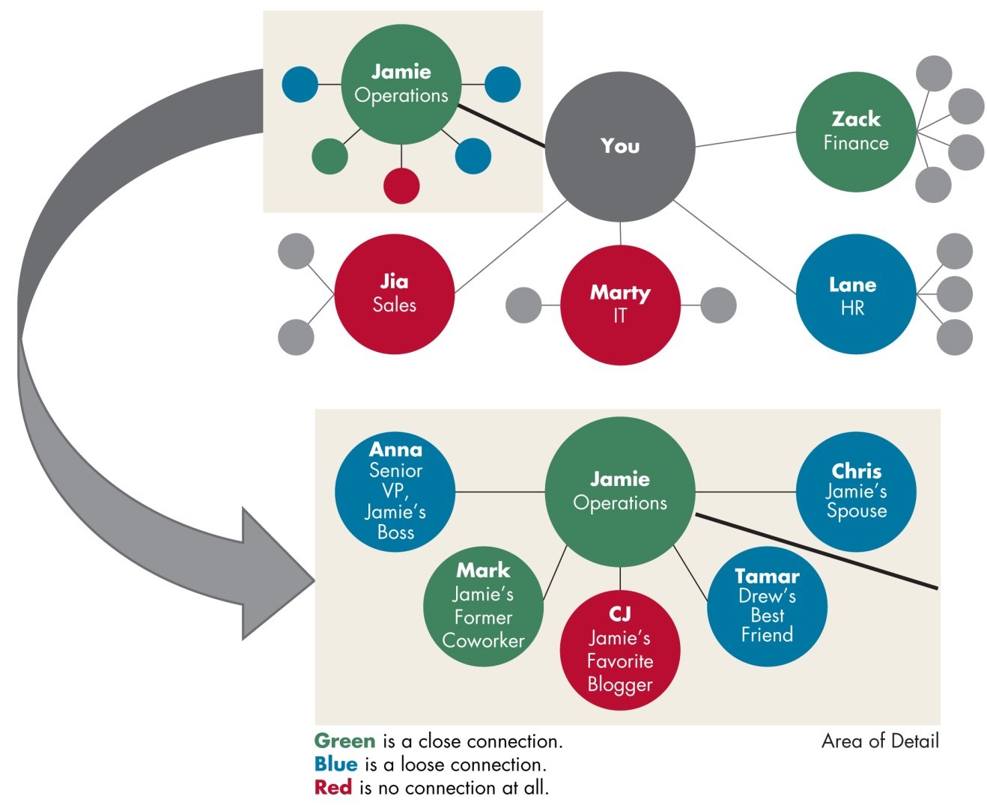
Causes and Consequences of Political Behavior (7 of 7)
Exhibit 11-7 Drawing Your Political Map
Notes:
Mapping your political career. One of the most useful ways to think about power and politics is in terms of your own career.
Think about your career in your organization of choice. What are your ambitions? Who has the power to help you get there? What is your relationship with these people? The best way to answer these questions is with a political map, like the one shown in Exhibit 13-7, which can help you sketch out your relationships with the people upon whom your career depends.
Power and politics are a part of organizational life. To decide not to play is deciding not to be effective. Better to be explicit about it with a political map than to proceed as if power and politics didn’t matter.

Slide 29
Implications for Managers (1 of 2)
To maximize your power, increase others’ dependence on you. For instance, increase your power in relation to your boss by developing a needed knowledge or skill for which there is no ready substitute.
You will not be alone in attempting to build your power bases. Others, particularly employees and peers, will be seeking to increase your dependence on them, while you are trying to minimize it and increase their dependence on you.
Try to avoid putting others in a position where they feel they have no power.
Notes:
Few employees relish being powerless in their job and organization. People respond differently to the various power bases. Expert and referent power are derived from an individual’s personal qualities. In contrast, coercion, reward, and legitimate power are essentially organizationally derived. Competence especially appears to offer wide appeal, and its use as a power base results in high performance by group members.
An effective manager accepts the political nature of organizations. Some people are significantly more politically astute than others, meaning that they are aware of the underlying politics and can manage impressions. Those who are good at playing politics can be expected to get higher performance evaluations and, hence, larger salary increases and more promotions than the politically naïve or inept. The politically astute are also likely to exhibit higher job satisfaction and be better able to neutralize job stressors.
How should managers deal with power and politics in their organization?
To maximize your power, increase others’ dependence on you. For instance, increase your power in relation to your boss by developing a needed knowledge or skill for which there is no ready substitute.
You will not be alone in attempting to build your power bases. Others, particularly employees and peers, will be seeking to increase your dependence on them, while you are trying to minimize it and increase their dependence on you.
Try to avoid putting others in a position where they feel they have no power.

Slide 30
Implications for Managers (2 of 2)
By assessing behavior in a political framework, you can better predict the actions of others and use that information to formulate political strategies that will gain advantages for you and your work unit.
Consider that employees who have poor political skills or are unwilling to play the politics game generally relate perceived organizational politics to lower job satisfaction and self-reported performance, increased anxiety, and higher turnover. Therefore, if you are adept at organizational politics, help your employees understand the importance of becoming politically savvy.
Notes:
By assessing behavior in a political framework, you can better predict the actions of others and use that information to formulate political strategies that will gain advantages for you and your work unit.
Consider that employees who have poor political skills or are unwilling to play the politics game generally relate perceived organizational politics to lower job satisfaction and self-reported performance, increased anxiety, and higher turnover. Therefore, if you are adept at organizational politics, help your employees understand the importance of becoming politically savvy.

Slide 31
Learning Objectives (1 of 2)
11.1 Contrast leadership and power.
11.2 Explain the three bases of formal power and the two bases of personal power.
11.3 Explain the role of dependence in power relationships.
11.4 Identify power or influence tactics and their contingencies.
Notes:
After studying this chapter, you should be able to:
Contrast leadership and power.
Explain the three bases of formal power and the two bases of personal power.
Explain the role of dependence in power relationships.
Identify power or influence tactics and their contingencies.

Slide 32
Learning Objectives (2 of 2)
11.5 Identify the causes and consequences of abuse of power.
11.6 Describe how politics work in organizations.
11.7 Identify the causes, consequences, and ethics of political behavior.
Notes:
Additional objectives for this chapter.
Identify the causes and consequences of abuse of power.
Describe how politics work in organizations.
Identify the causes, consequences, and ethics of political behavior.

Slide 33
Questions?
What types of power and politics are used in your organization?

